Slide 1


Slide 2
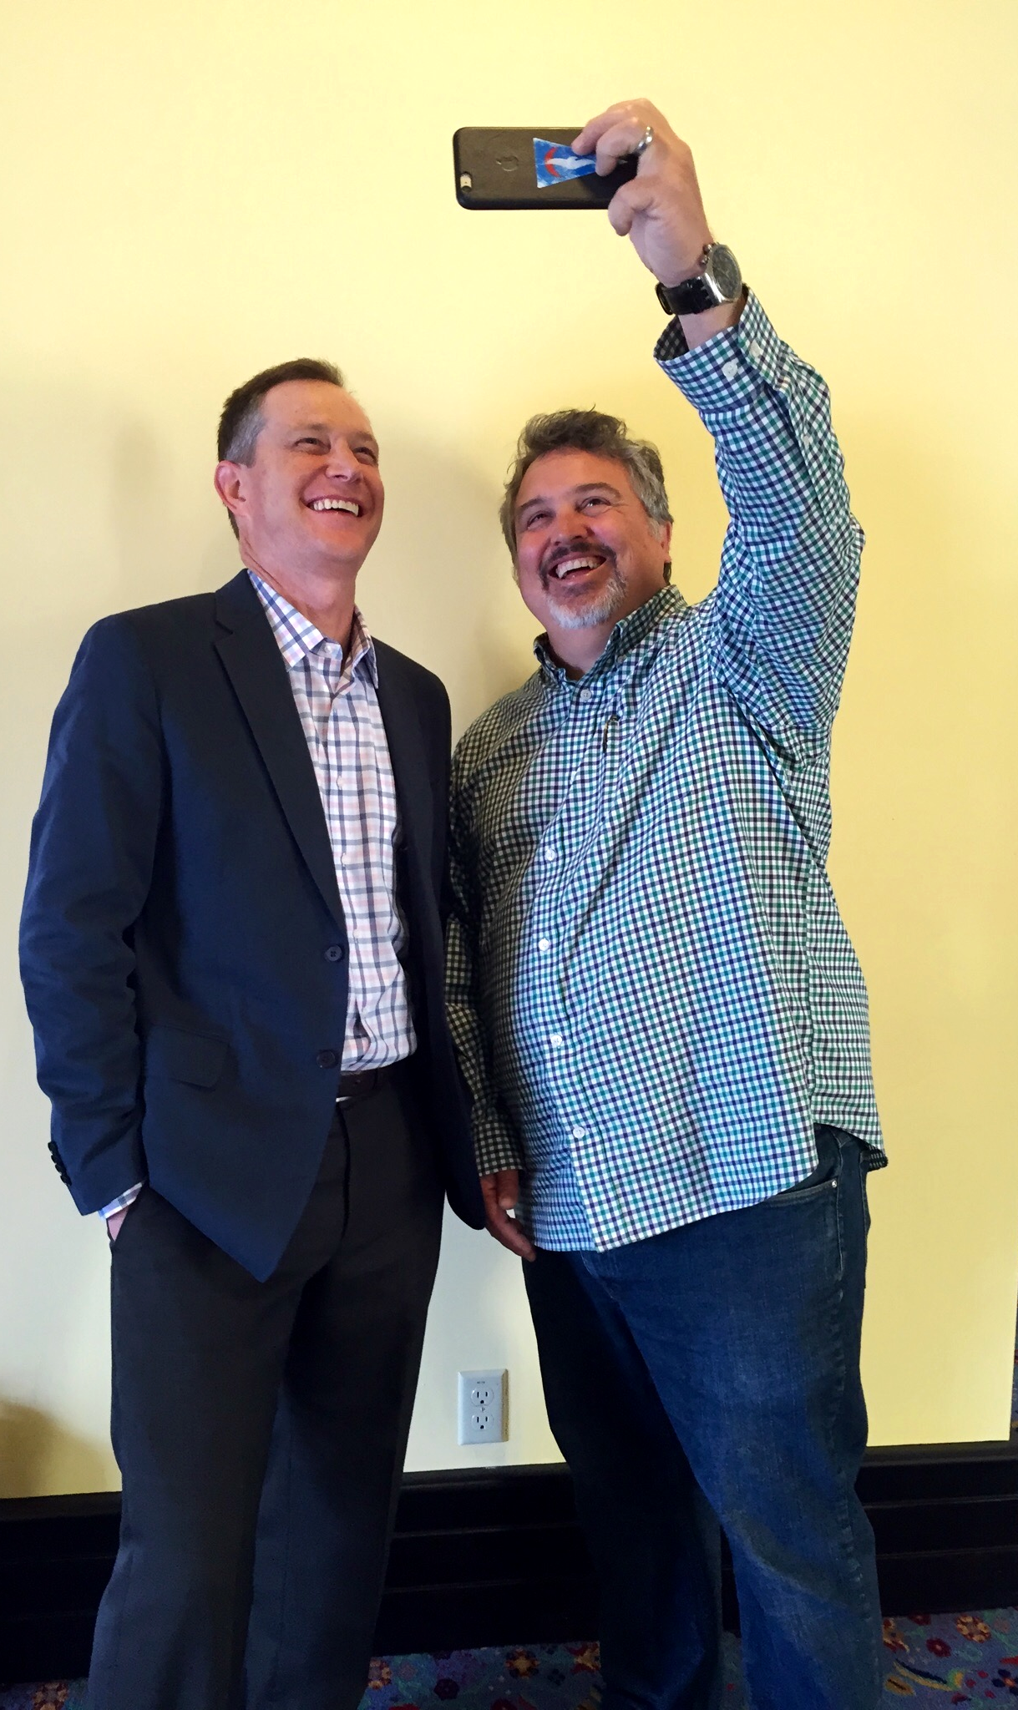
Bruce:
bruce@hadfieldjones.com / @BMcCJ
Jeff:
jeff@hadfieldjones.com / @jhadfield
hadfieldjones.com
@hadfieldjones

Slide 3
Success Stories
Have launched 7 new developer programs
Grown programs from 0 to over 3M developers
Created multinational event experiences
Launched new hardware platforms with developer focus
Executed award-winning launches & keynotes, spoken to audiences from 5 to 5,000
Built worldwide outreach with regional events and localized marketing
Built and run content marketing efforts, produced web and print publications reaching from 120,000 to 5,000,000 readers a month
Launched mobile platforms and seeded initial app store developers
Built successful developer communities
Notes:
(combined experience)

Slide 4
We help companies, from startup to global, understand, build, run, promote and measure their developer programs.

Slide 5



































Slide 6

JEFF HADFIELD
@jhadfield
Marketer, Publisher, Speaker, Coach, Editor, Writer, Entrepreneur
SAP Developer Advisory Board, Developer Media, CodeProject, Visual Studio Magazine, JavaPro Magazine, VSLive! and related events, Enterprise Architect Magazine, Fawcette Technical Publications, author of Web publishing books

Slide 7

Bruce Jones
@BMcCJ
Engineer, MBA Entrepreneur
Head of Developer Relations Developer Evangelist Huawei, Honda, PayPal, Verifone, HTC, GetJar, EventRadar, Ford

Slide 8
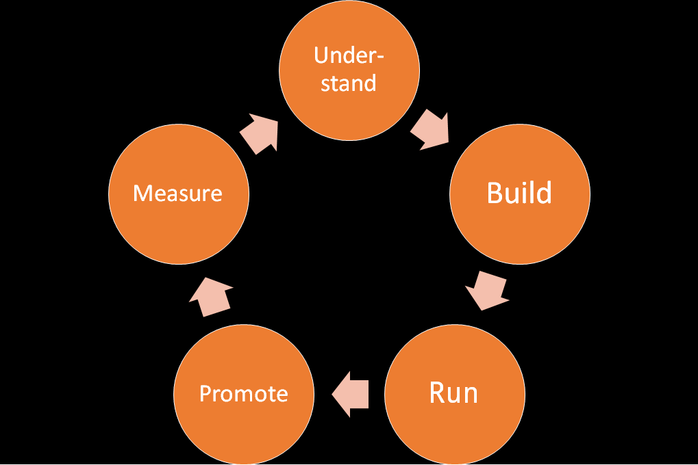

Slide 9
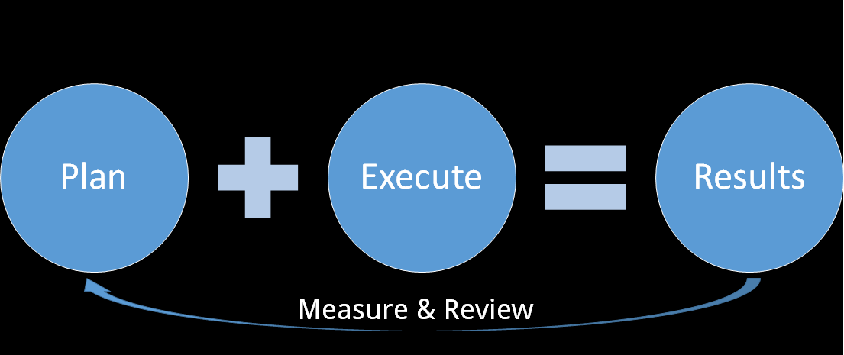
What we do

Slide 10
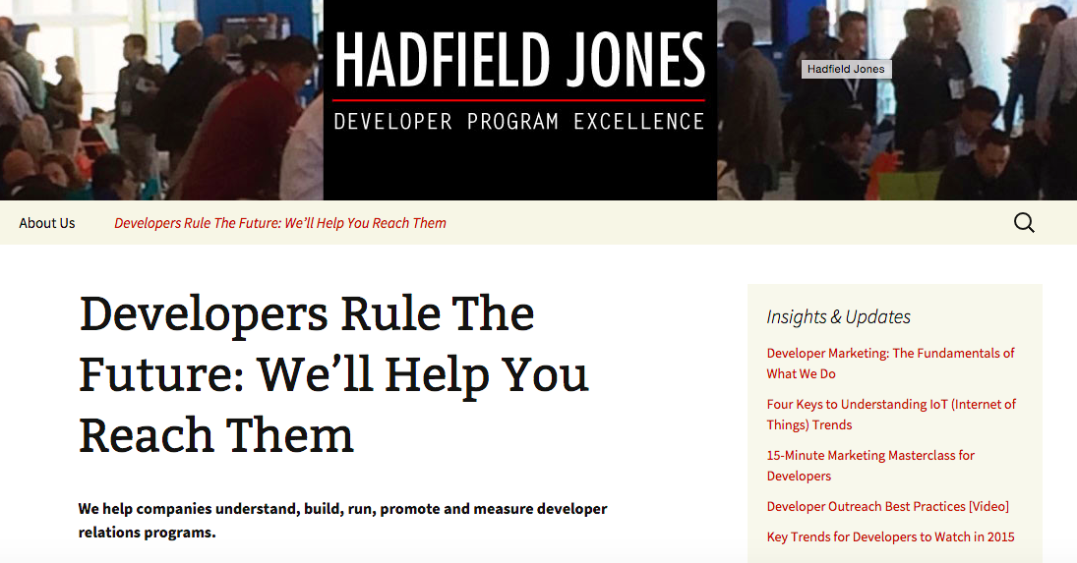

Slide 11
“The world is rapidly being reshaped by software.
It’s changing everything: how we work, how we monitor our health, how we spend time with our families, and more.
Over time, quality of life around the world will continue to increase as a result of today’s unsung heroes: software developers.
With more developers writing apps, we’ll see even more innovation and a world we can’t even dream of today.”
- Apprenda

Slide 12
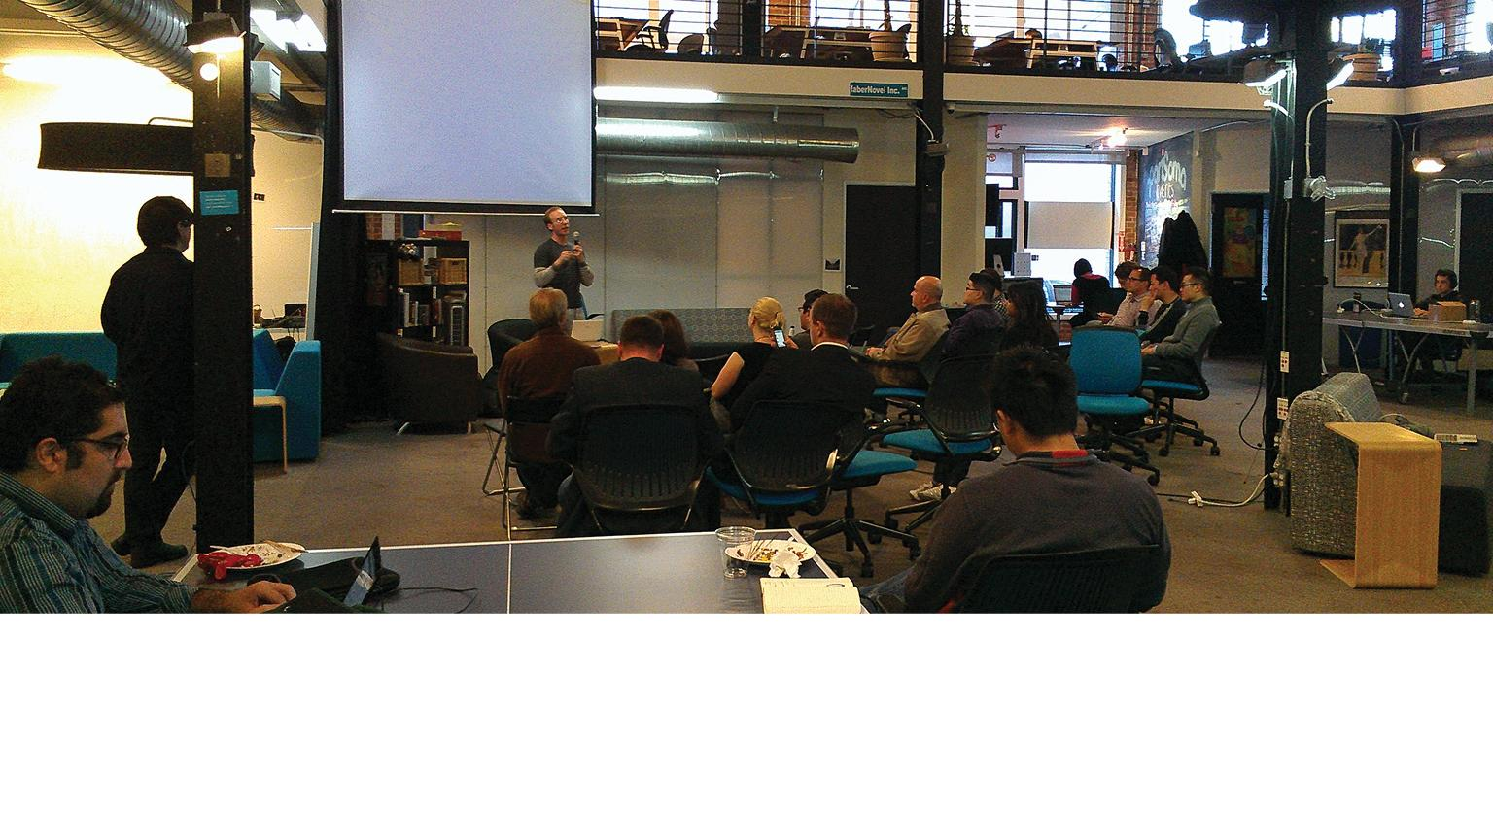
Developers = Growth

Slide 13
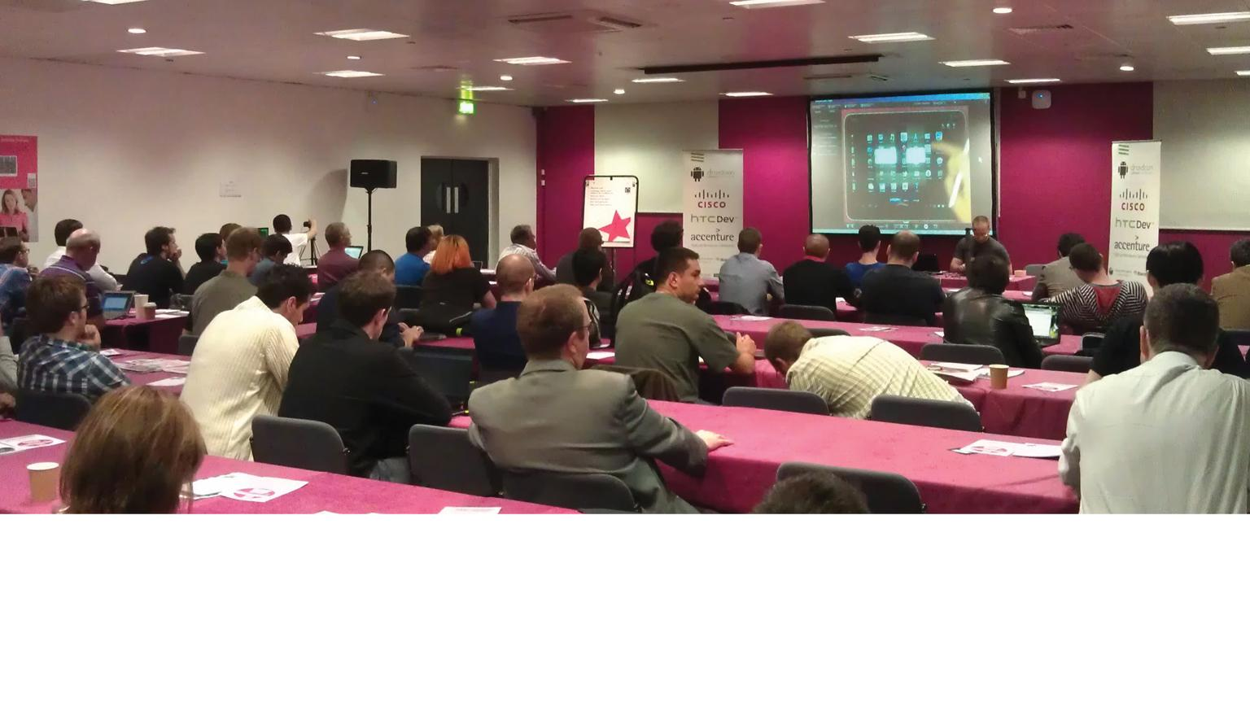
More trials, more downloads, more sales

Slide 14
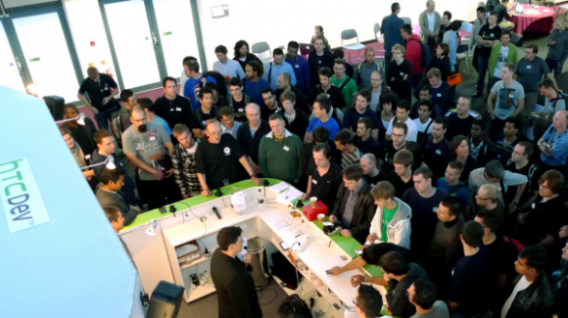
More content, bigger audience

Slide 15
Thus, more and more companies are starting developer programs to reach this important market.

Slide 16
But most people need help understanding and reaching developers — and building, running and measuring their developer programs.

Slide 17
HADFIELD JONES helps you:
Understand
Build
Run
Promote
Measure

Slide 18
HADFIELD JONES is a consultancy focusing on helping companies achieve
Developer Program Excellence

Slide 19

Developers are Changing the Game
Notes:
Google Chrome national advert features animated ad featuring the developers of Angry Birds.

Slide 20
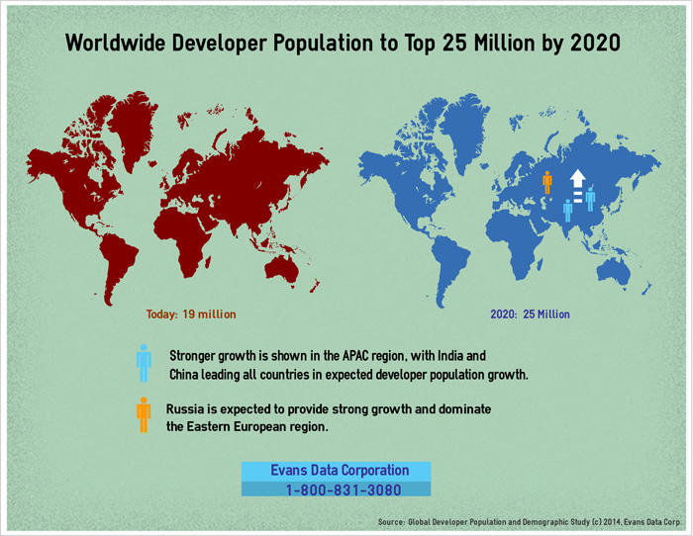

Slide 21
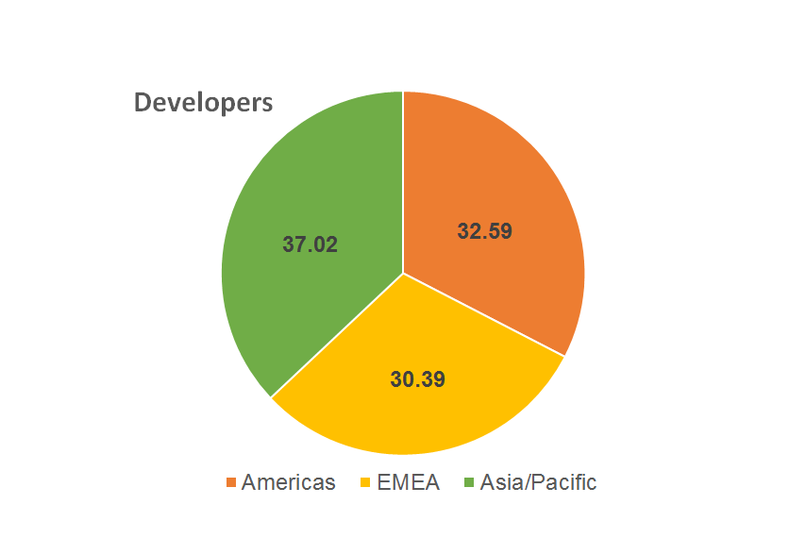

Developers are Worldwide, but ...
Source: IDC 2014

Slide 22
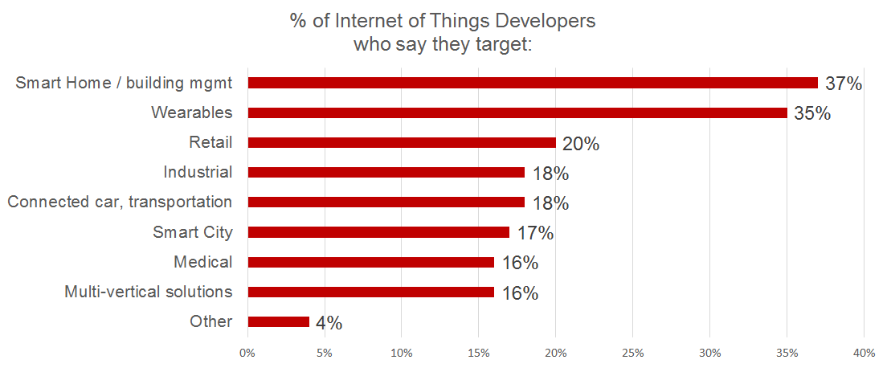
What are IoT Developers Currently Doing?
Source: Vision Mobile
Notes:
Source: Vision Mobile IoT survey

Slide 23
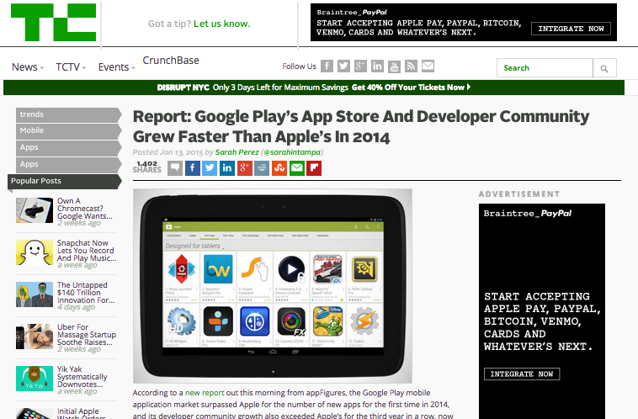
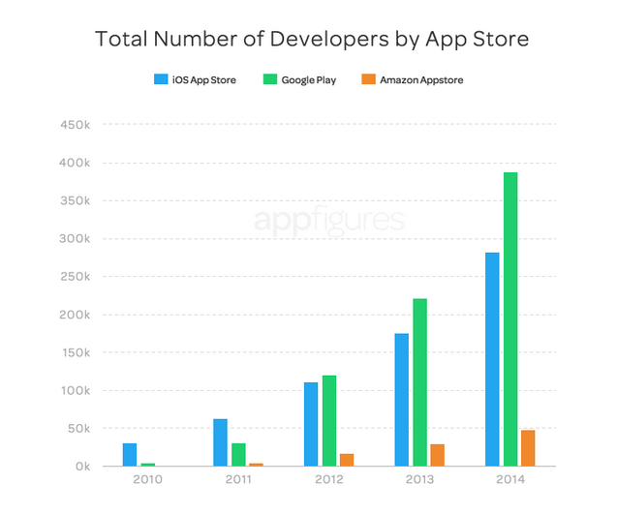
Facts & Futures

Slide 24
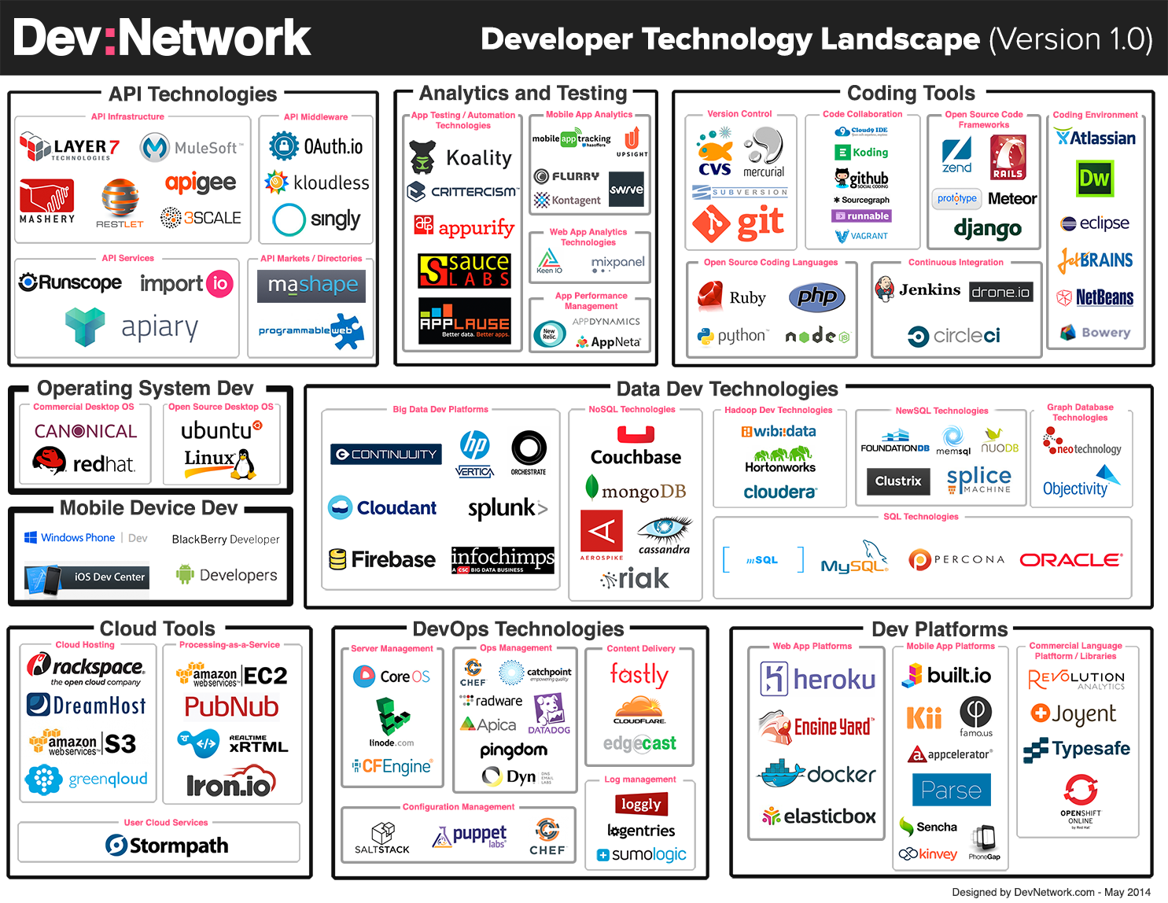
Developer TOOL Landscape
Develover Tools Abound

Slide 25
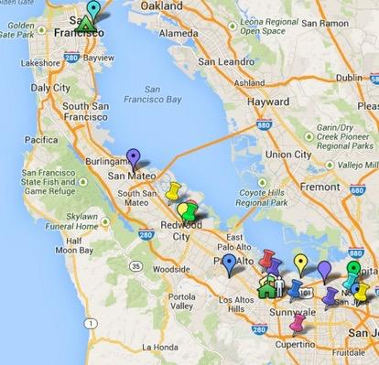
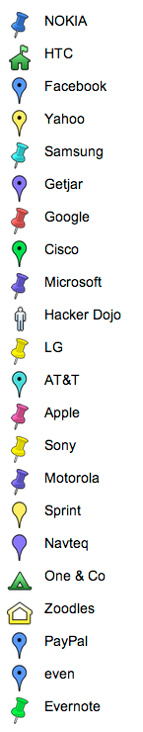
Developer Programs Silicon Valley
Silicon Valley has the largest and oldest developer, iOS and Android concentrations

Slide 26



















Who targets which developers?
Physical Goods
Consumer
Enterprise
Software/Data

Slide 27
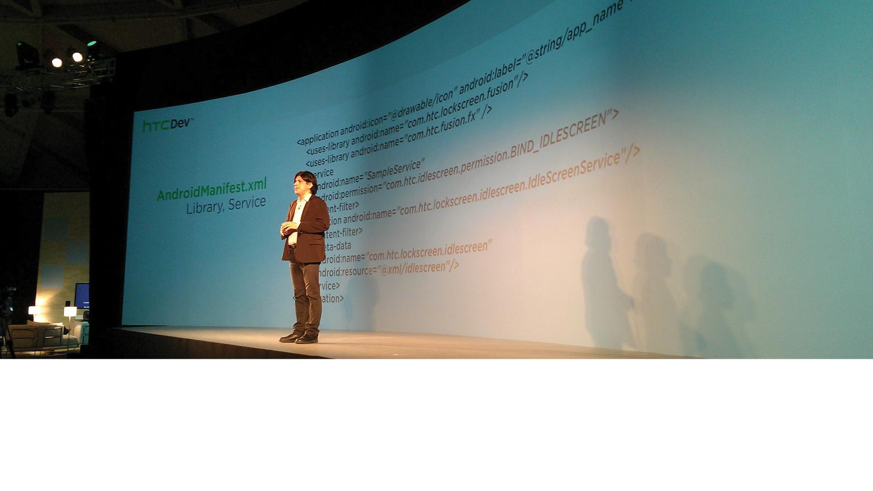
Presentations / Keynotes

Slide 28
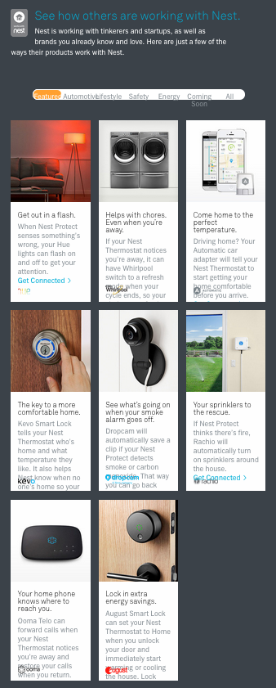
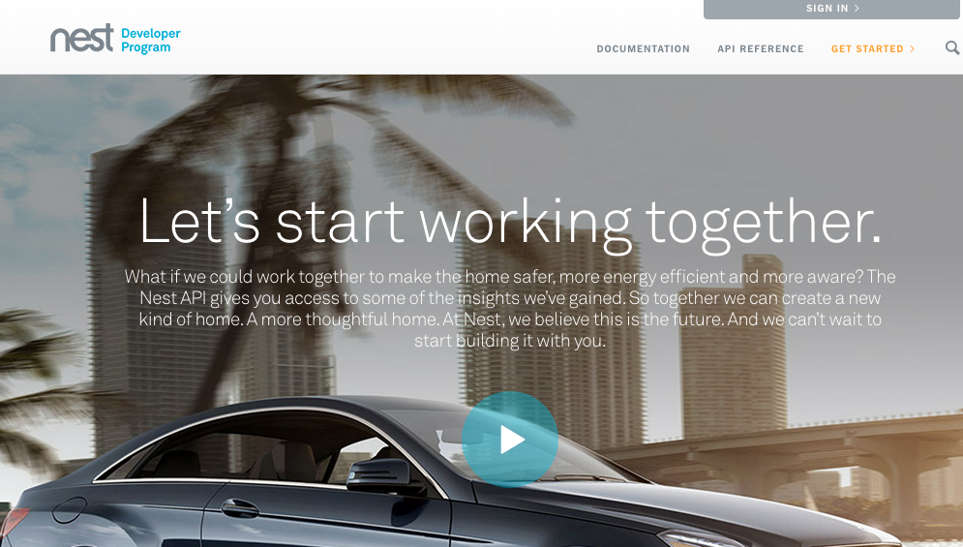
Best Practices

Slide 29
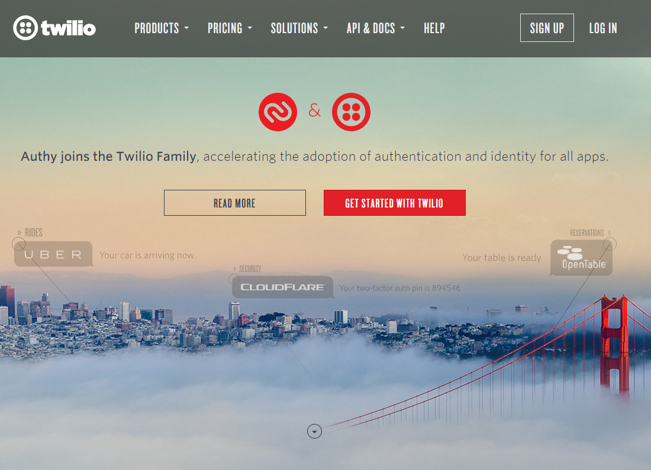
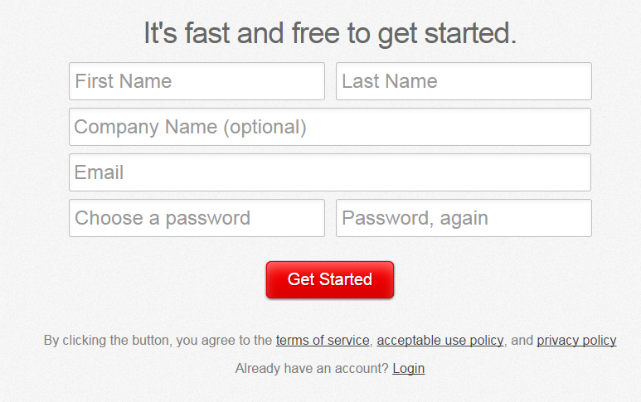
Connect and Capture Developers

Slide 30
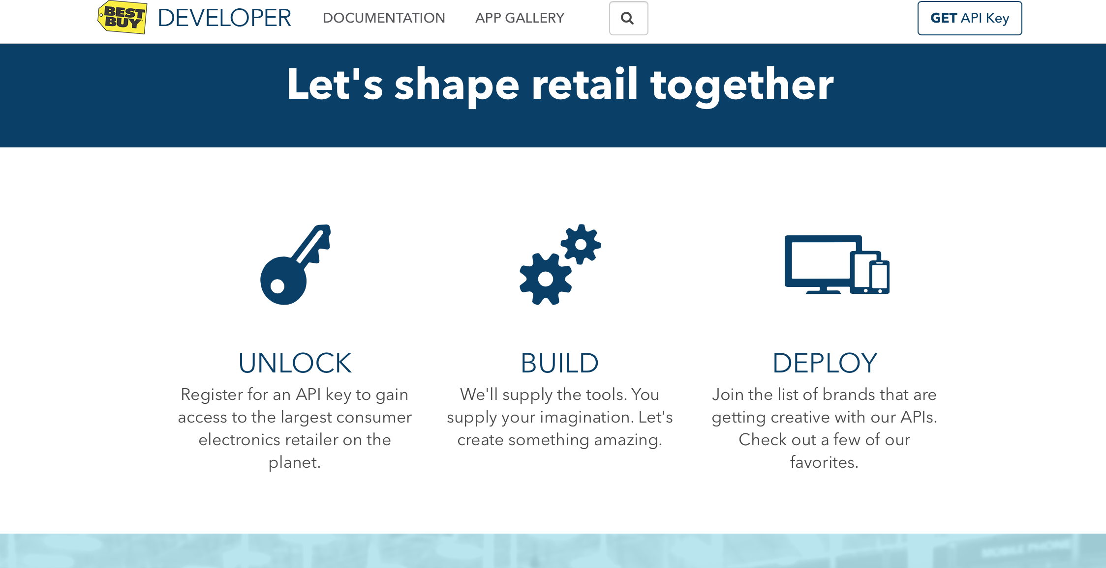
Clear Message to Developers

Slide 31
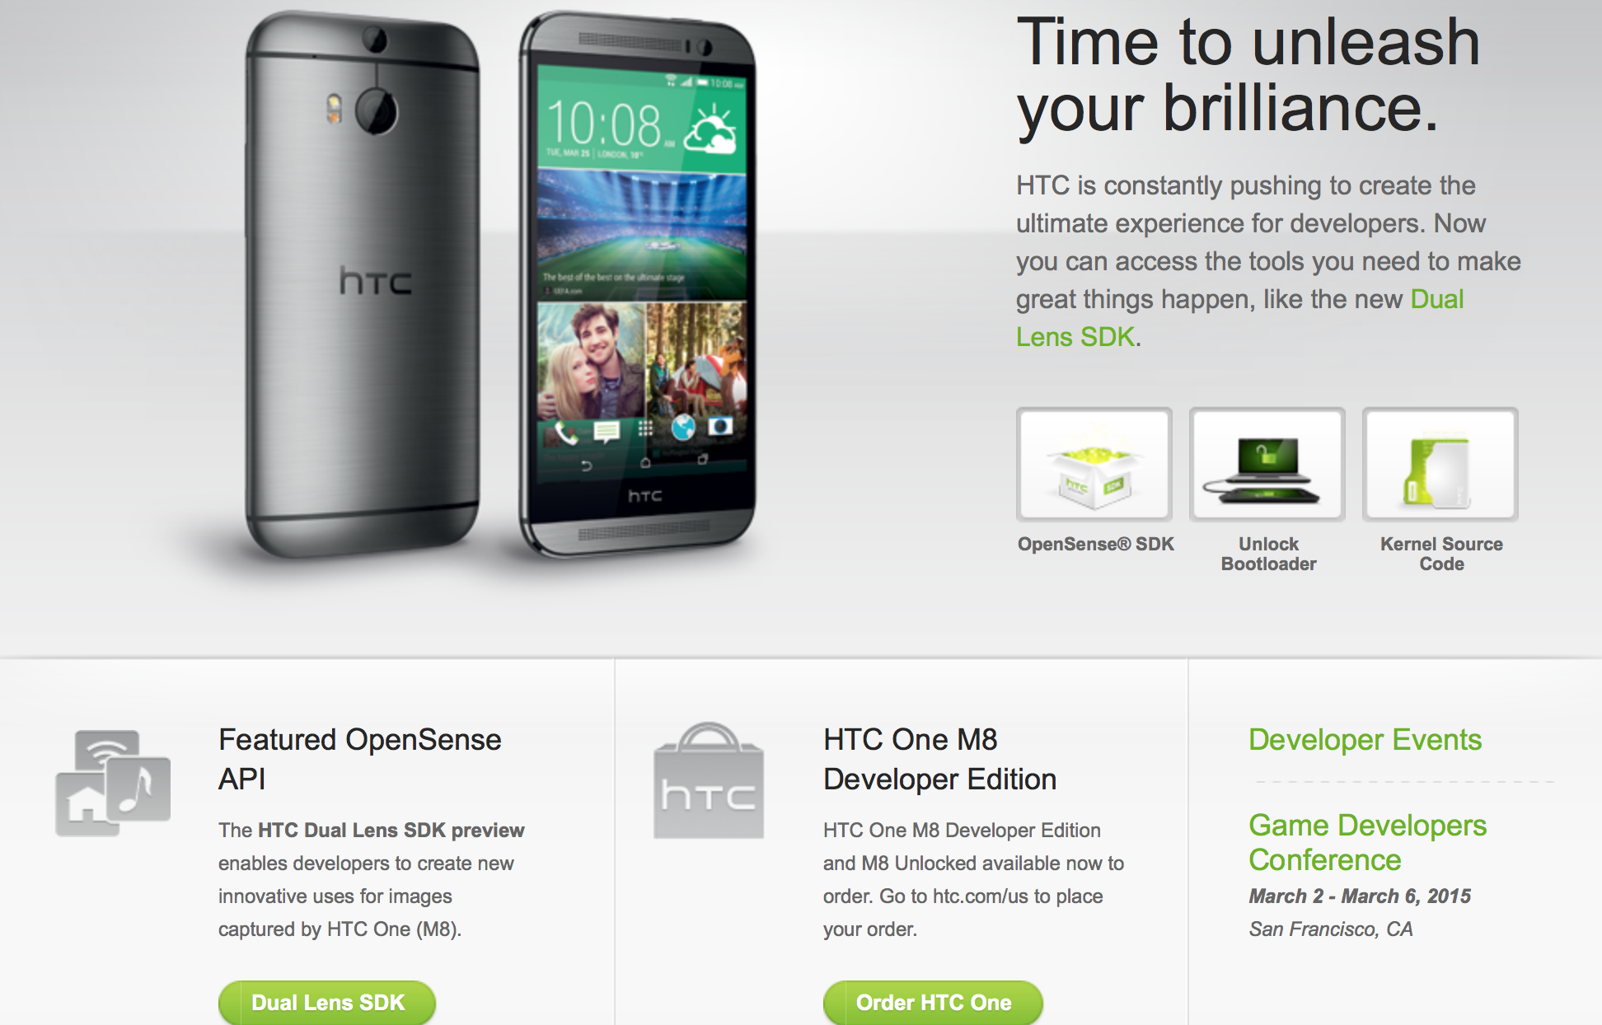
Support Android Extensions
In the first 9 months ~ 200 Countries
~ 2M Signups
Android Specific
Unlock Phone
Source Code Downloads (Open Source)
Emulators
Developer Phone

Slide 32
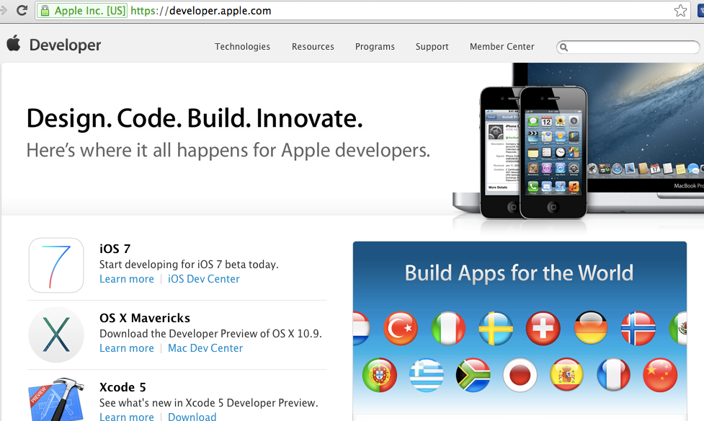
Extend Global Product Content

Slide 33
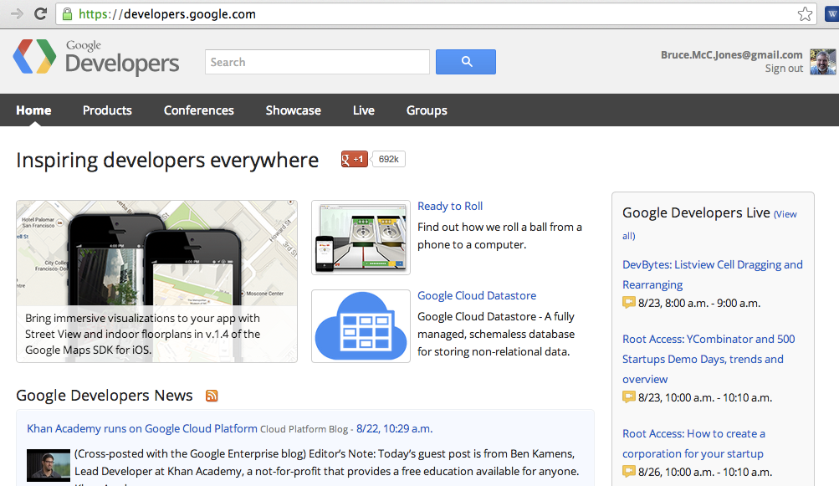
Inspire Technologists

Slide 34
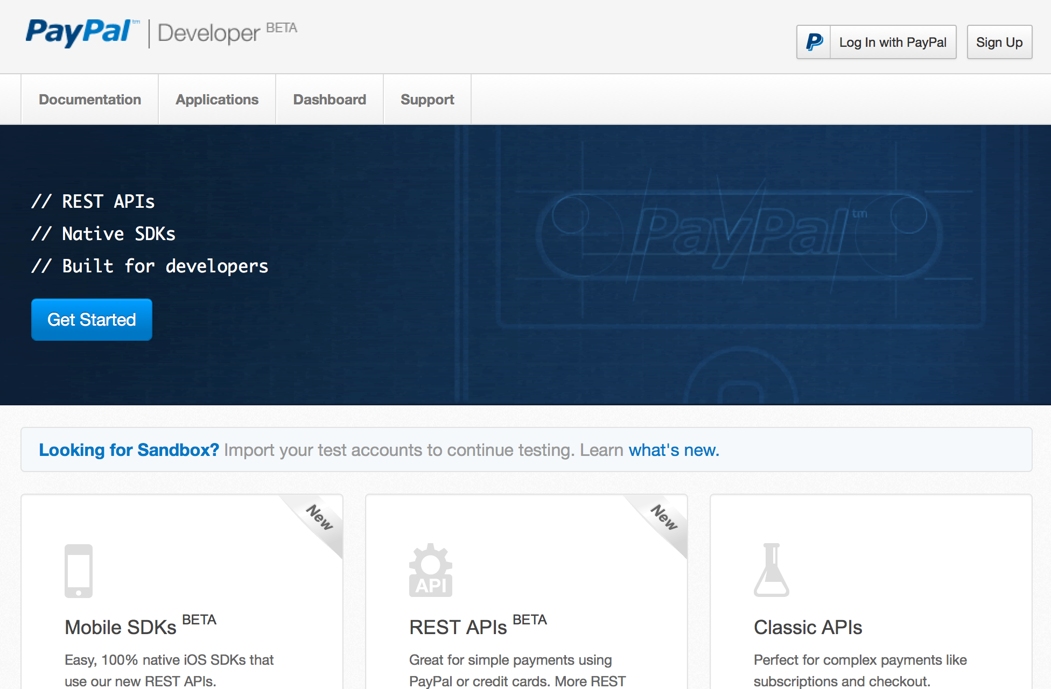
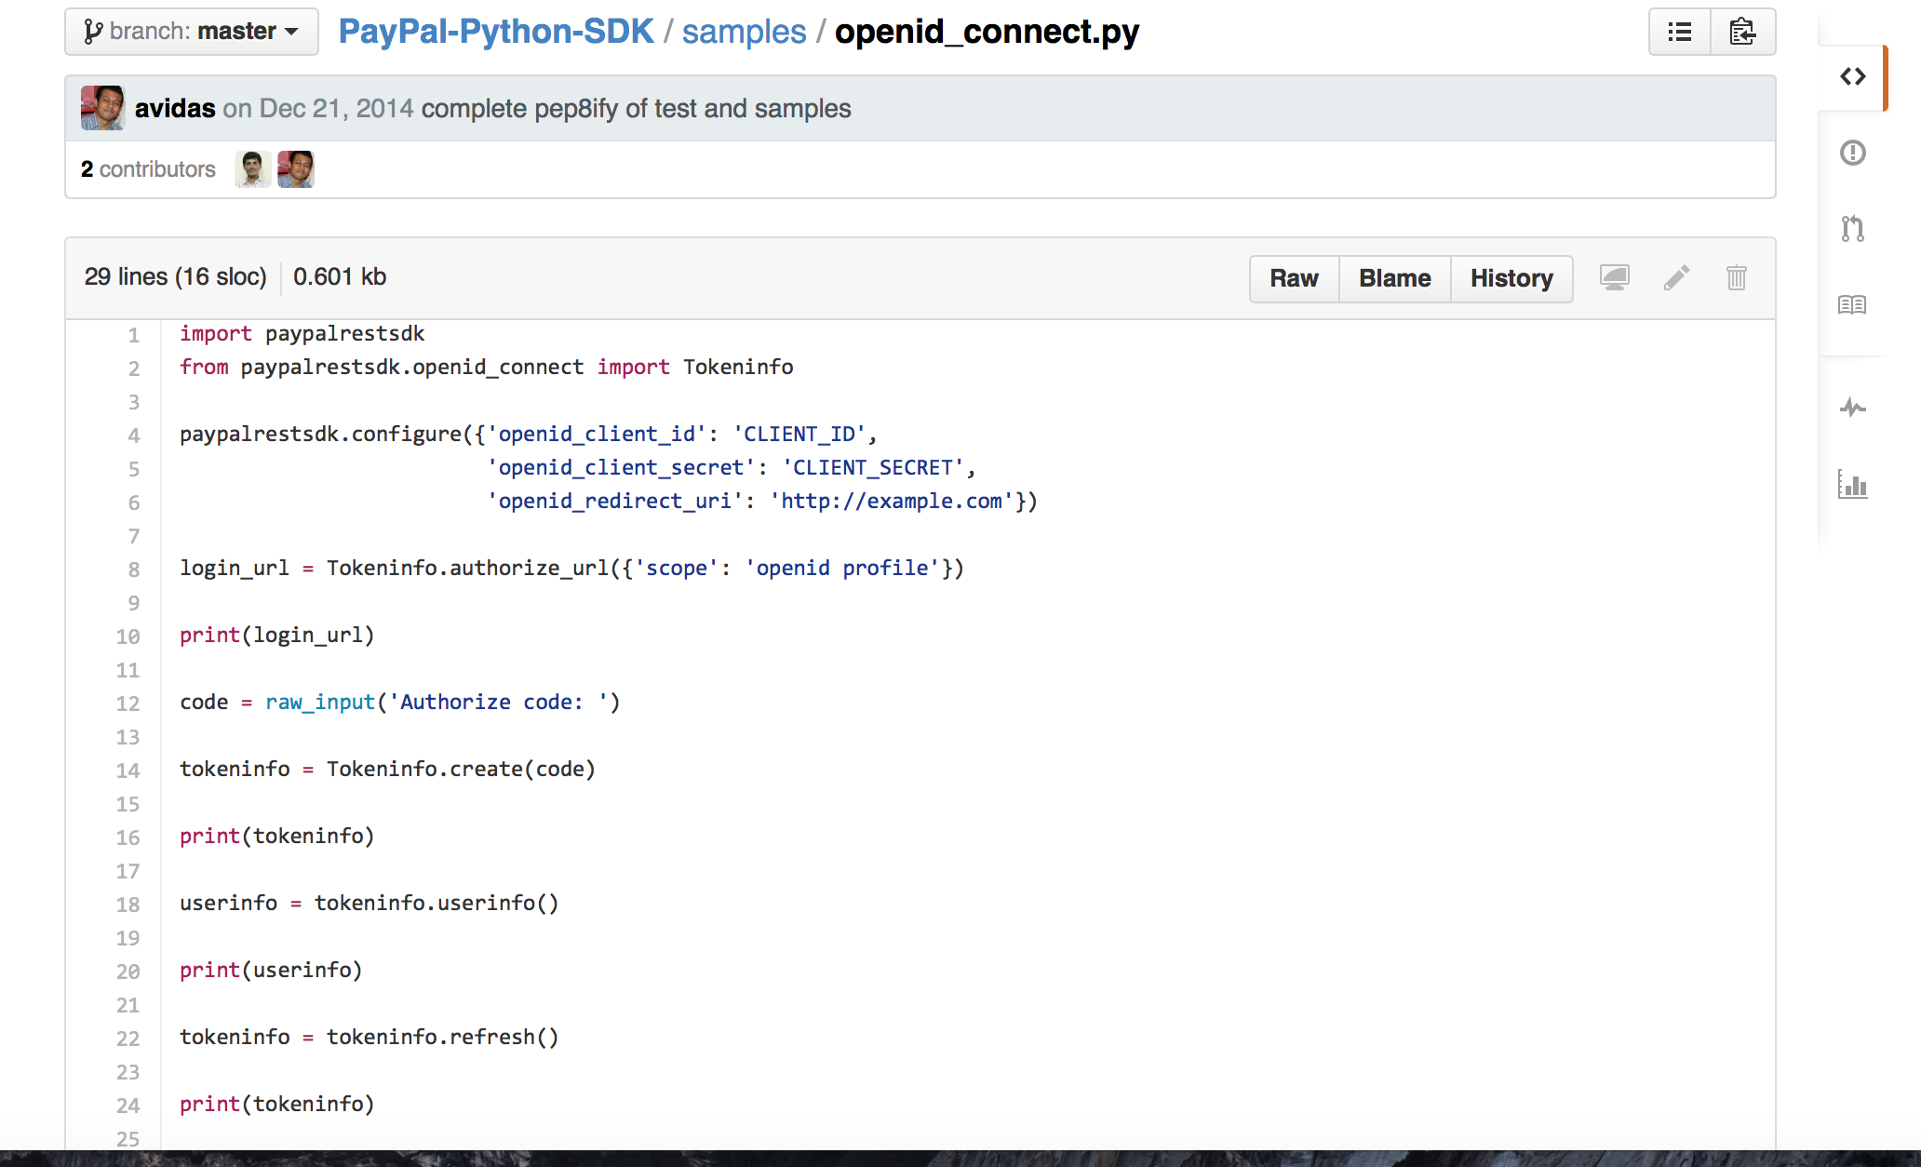
Provide Sample Source Code

Slide 35
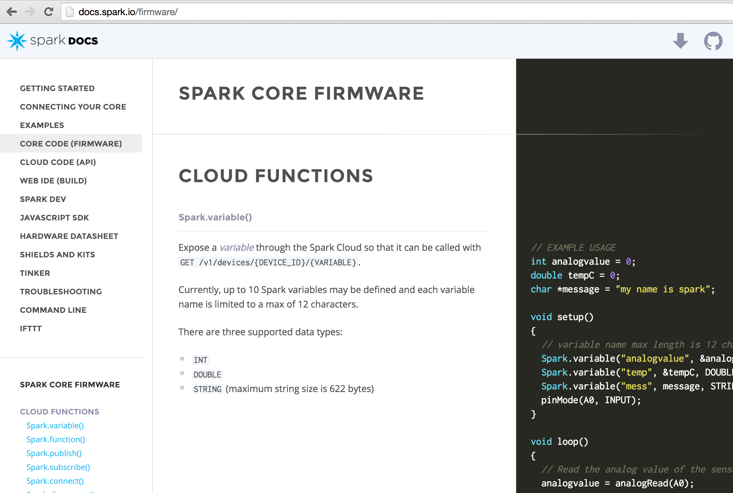

Provide Sample Source Code

Slide 36
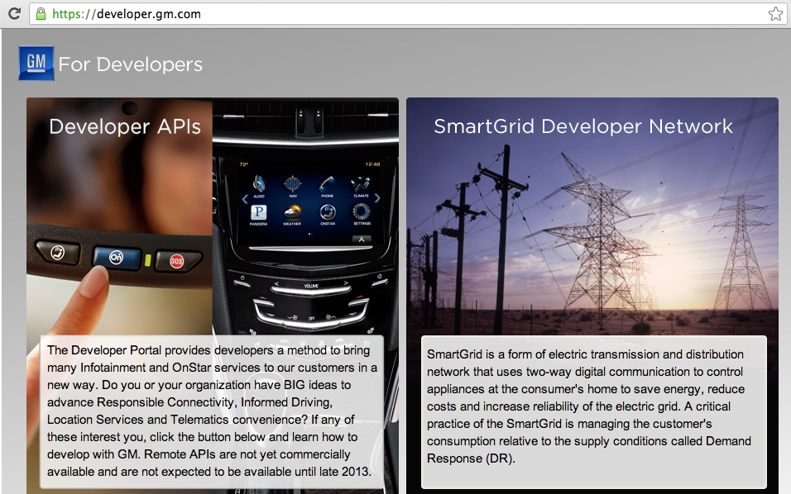
Avoid Multiple Developer Programs

Slide 37
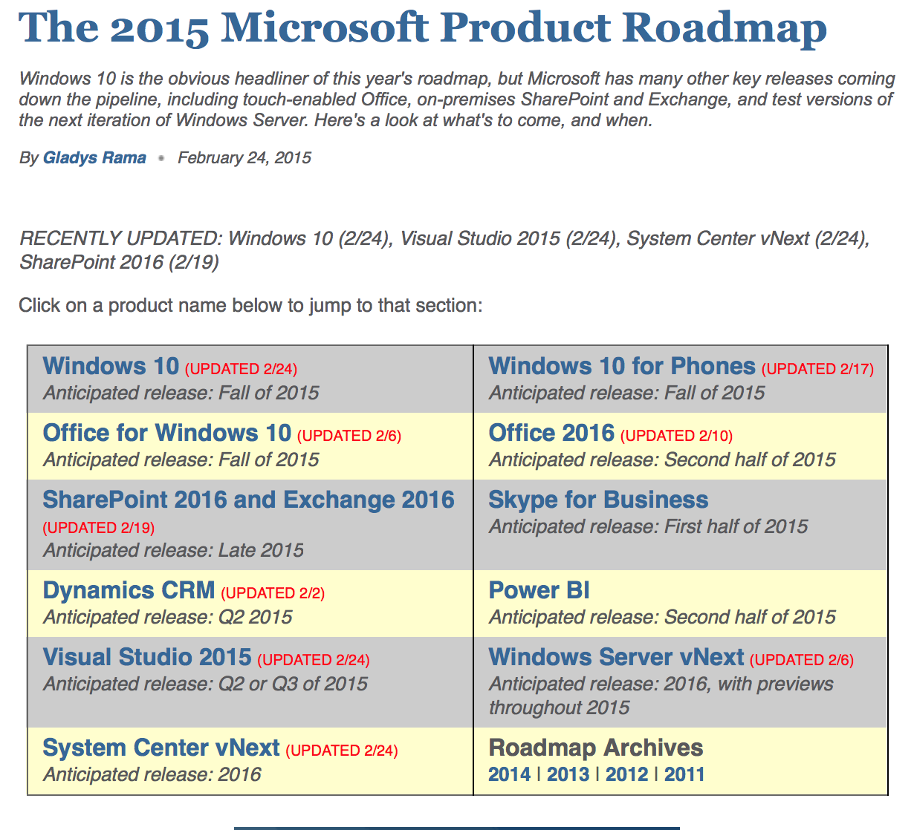
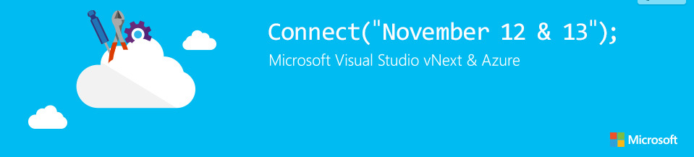
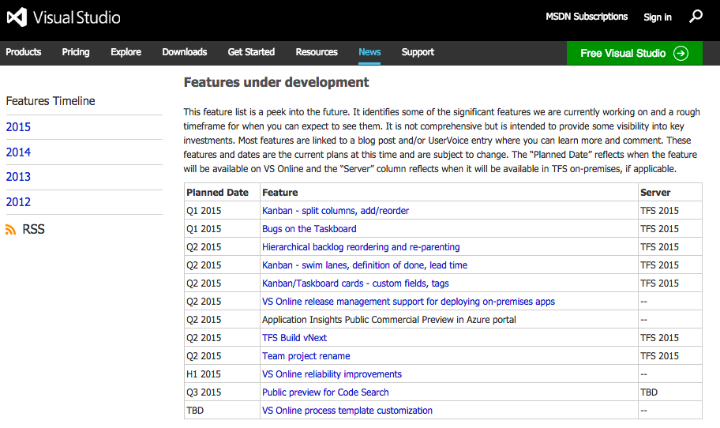
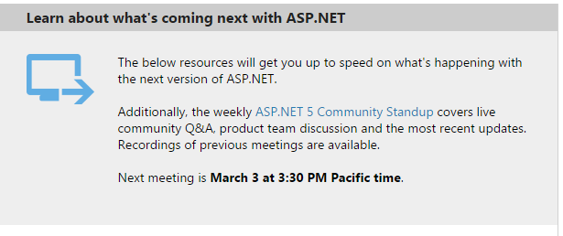
Publish Release Schedules

Slide 38
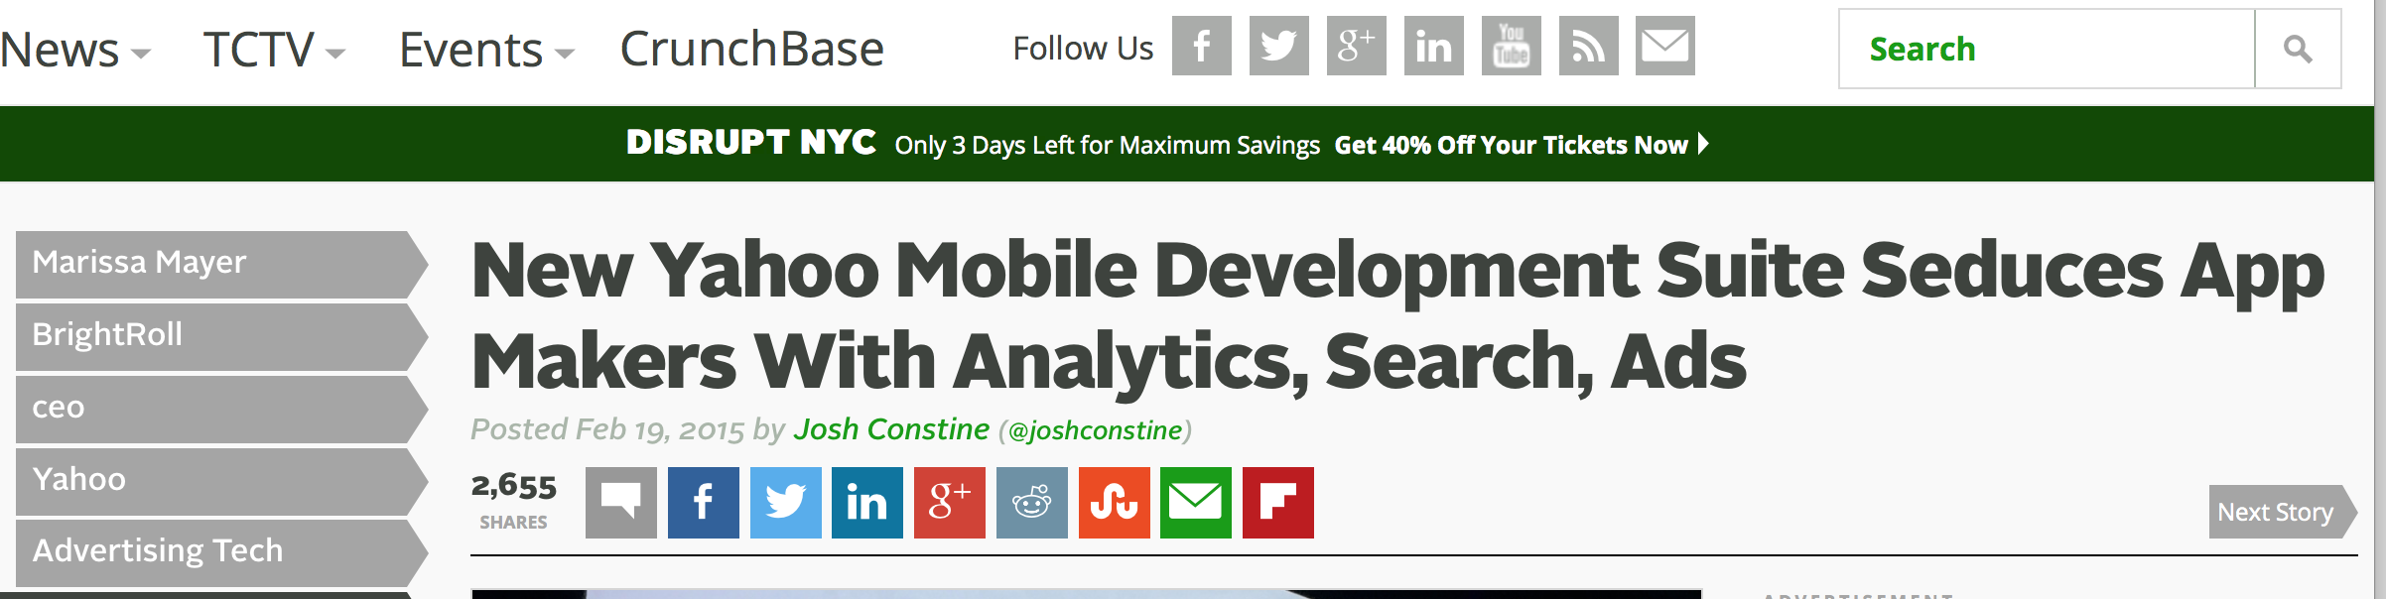
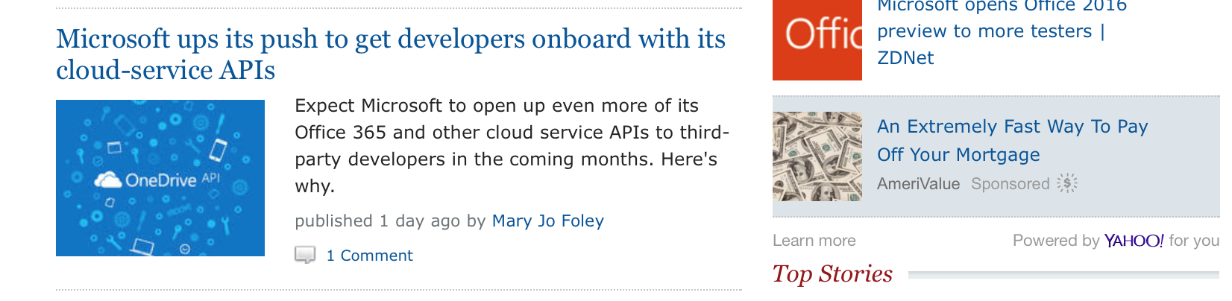
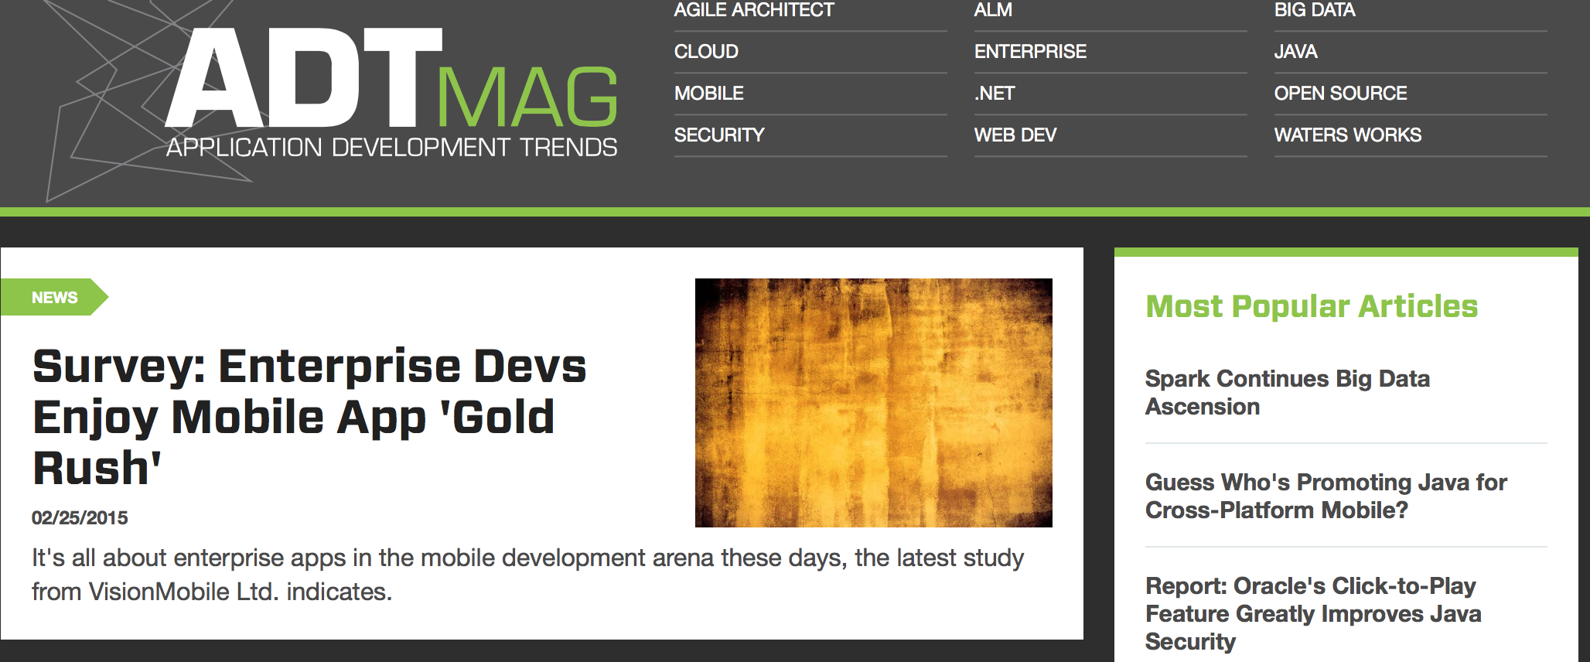
Become a news story to developers

Slide 39
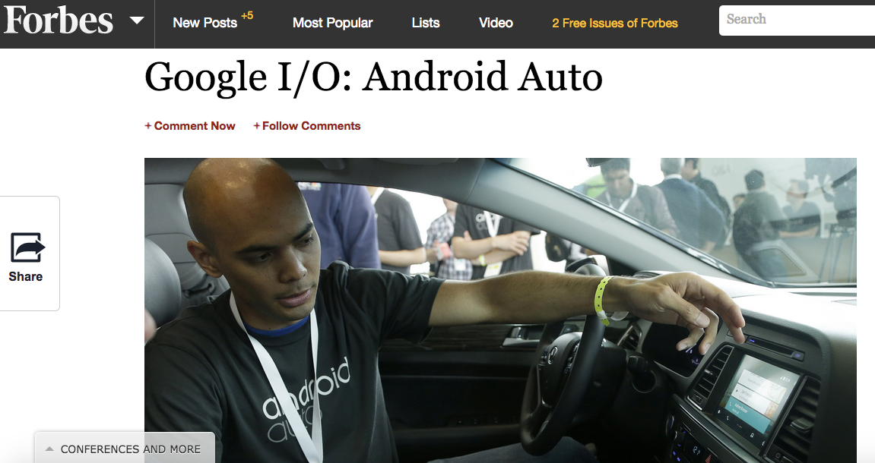
Honda at Google I/O
movie

Slide 40
Developer Program Best Practices
Build It
Support Android extensions
Respect global developers and business opportunities
Run It
Connect & capture info
Provide sample source code
Centralize, don’t have multiple programs
Promote It
Inspire with real examples
Clear call to action
Inspire technically
Publish release schedules
Be developer news stories

Slide 41


Parties of a Developer Ecosystem
3rd Party Developers
4th Party Consumers
B2B App Users
2nd
Platform/
tools/ services
1st Party
2nd Party Partners (B2B)

Slide 42
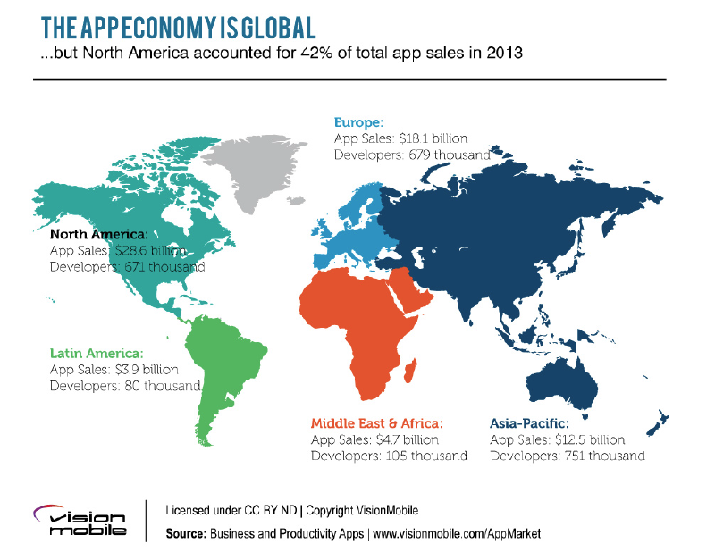

Slide 43
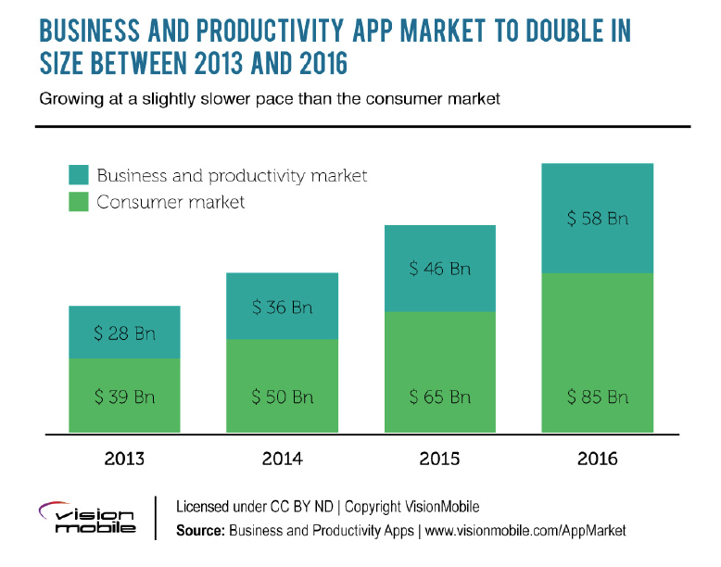
Opportunity: Business over Consumer

Slide 44
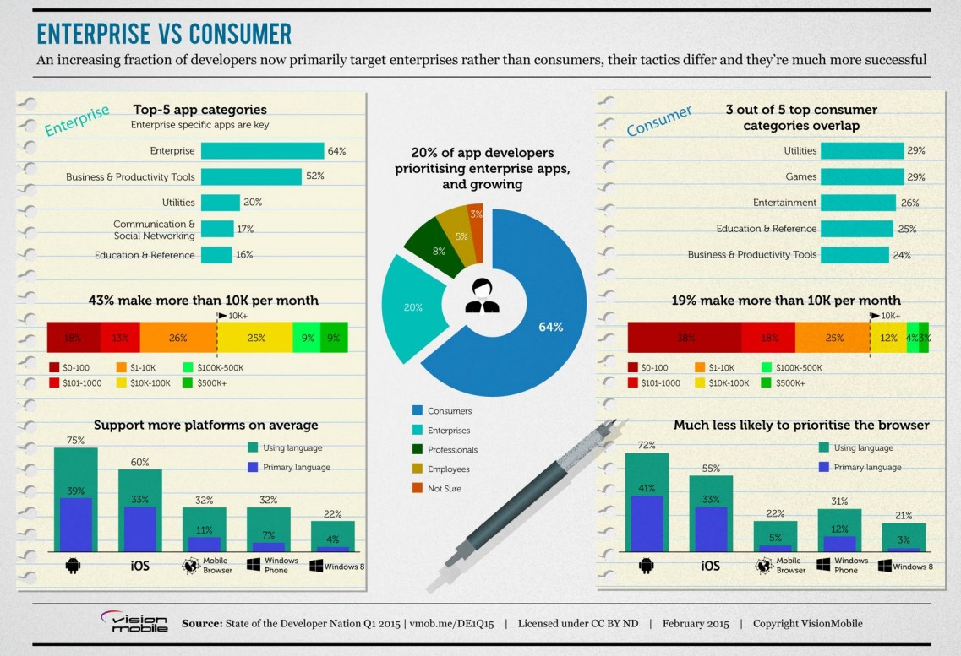

Slide 45
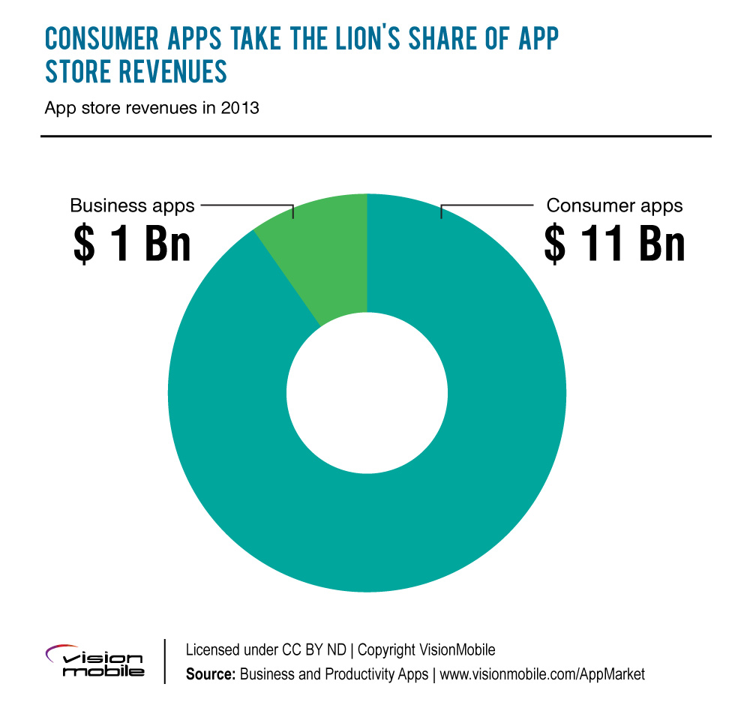
Opportunity: Business over Consumer
Most business apps NOT sold in app stores
Business apps projected to grow to $6Bn by 2016

Slide 46
Bruce:
bruce@hadfieldjones.com / @BMcCJ
Jeff:
jeff@hadfieldjones.com / @jhadfield
hadfieldjones.com
@hadfieldjones

Slide 47
Developer Relations Experts
Technical Field Evangelism
Authors, Publishers
Community Engagement Gurus
Content & Social Marketers

